Slide 1
UNIT:6
EXCEPTION HANDLING AND STREAM IO
7hrs
Presented by
Er.Harendra Bikram Shah
Lecturer
Department of Computer Engineering
NAST

Slide 2
OUTLINES
Introduction to Exception and Exception Handling
Introduction to mechanism of exception handling
File handling: Stream Class hierarchy
Opening ,closing Reading and Writing File

Slide 3
Introduction to Exception and Exception Handling
An exception are unexpected condition arise during execution of program.
An exception is a abnormal problem that arises during the execution of a program.
Exception Handling in C++ is a process to handle runtime errors.
There are two types of exceptions:
a)Synchronous: Example: out of range ,out of length etc.
b)Asynchronous : disc failure, keyboard interrupts etc.).

Slide 4
Exception are handled by following three keywords
try: Represents a block of code that can throw an exception.
catch: used to catch the exception from throw keyword
throw: Used to throw an exception.
Advantages of Exception handling
1) Separation of Error Handling code from Normal Code
2) Functions/Methods can handle only the exceptions they choose
3) Grouping of Error Types

Slide 5
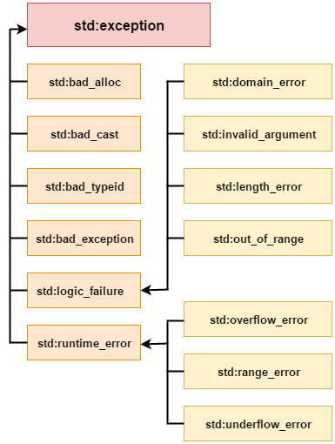
STANDARD EXCEPTION

Slide 6
Introduction To Mechanism Of Exception Handling
try {
throw exception;
}
catch () {
}
Example:
try {
int age = 15;
if (age >= 18)
{
cout << "Access granted - you are old enough.";
}
Else
{
throw (age);
}
}
catch (int myNum) {
cout << "Access denied - You must be at least 18 years old.\n";
cout << "Age is: " << myNum;
}

Slide 7
CATCH all the Exceptions (...)
try {
//code
}
catch (...)
{
//
Code
}
EXAMPLE:
try {
int age = 15;
if (age >= 18) {
cout << "Access granted - you are old enough.";
} else {
throw 505;
}
}
catch (...) {
cout << "Access denied - You must be at least 18 years old.\n";
}

Slide 8
MULTIPLE catch
#include<iostream>
using namespace std;
int main()
{
int a=10;
try
{
if(a>10)
{
cout<<"inside try block"<<endl;
}
else
{
throw(a);
}
}
catch(double b)
{
cout<<"exception caught"<<b;
}
catch(int b)
{
cout<<"exception caught"<<b;}
return 0;}
try {
// code
}
catch (exception1)
{
// code
}
catch
(exception2)
{
// code
} catch (...) { // code }

Slide 9
Exception Handling In Function
#include<iostream>
using namespace std;
void fun(int a)
{
throw(10);
}
int main()
{
int a=10;
try
{
if(a>10)
{cout<<"inside try block"<<endl;}
else
{
fun(a);
}
}catch(int b)
{
cout<<"exception caught"<<b;}
return 0;}

Slide 10
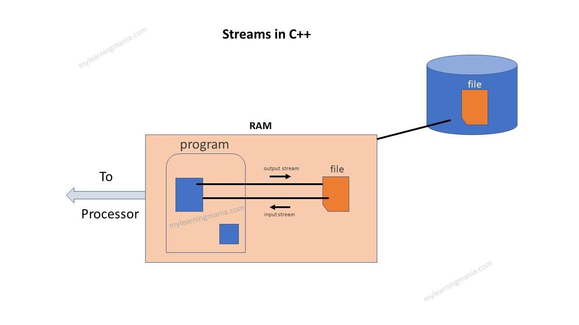
File handling in C++

Slide 11
File handling in C++
File Operations in C++
open() – This is used to create a file.
read() – This is used to read the data from the file.
write() – This is used to write new data to file.
close() – This is used to close the file.
Opening files in C++
Syntax:
1 | open( FileName , Mode );

Slide 12
File handling in C++
Mode | Description
iso::in | File opened in reading mode
iso::out | File opened in write mode
iso::app | File opened in append mode
iso::ate | File opened in append mode but read and write performed at the end of the file.
iso::binary | File opened in binary mode

Slide 13
Opening a file in C++
#include<iostream>
#include<fstream>
using namespace std;
int main(){
fstream Fn;
Fn.open("FileName", ios::out);
if (!Fn)
{
cout<<"Error while creating the file";
}
else{
cout<<"File created successfully";
Fn.close();
}
return 0;
}

Slide 14
Writing to file in C++
#include<iostream>
#include<fstream>
using namespace std;
int main() {
ofstream Fout;
Fout.open("FileName.txt", ios::out);
if (!Fout)
{
cout<<" Error while creating the file ";
}
else {
cout<<"File created and data got written to file";
Fout<<"hello from file";
Fout.close();
}
return 0;
}

Slide 15
Reading from file in C++
#include<iostream>
#include <fstream>
using namespace std;
int main() {
ifstream Fin;
Fin.open("FileName.txt", ios::in);
if (!Fin) {
cout<<"File doesn’t exist.";
}
else {
char x;
while (1) {
x=Fin.get();
if(Fin.eof())
break;
cout<<x;
}
}
Fin.close();
return 0;
}

Slide 16
END of THE UNIT 6

Slide 17
THANK YOU

